Slide 1
Deadmans Head Forest
Emilie Noel, Abigail Evans, Rohan Mishra, Peter Anyah

Slide 2
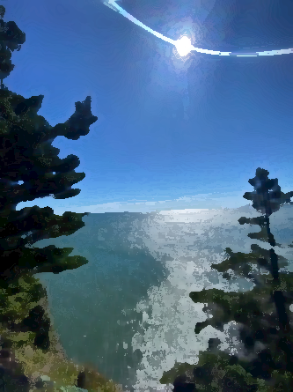
Overview
Introduction
Recap
Tree Data
Species Data
NDVI Mapping
Climate Predictions
LanDSET model

Slide 3
Introduction
Site Characteristics
Background

Slide 4
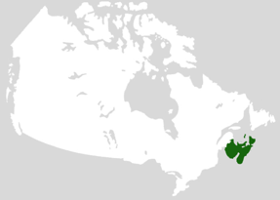
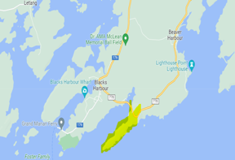
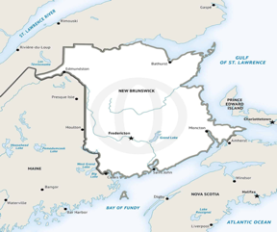
Deadmans Head Forest Characteristics
New England Acadian Forest
Located in the town of Blacks Harbor on the Bay of Fundy in Southwestern New Brunswick
Length ~ 3km
Area ~ 3 ha
Peninsula surrounded by water on 3 sides
Mid successional forest
Acadian Forest Presence in Canada
Deadmans Head Forest
New Brunswick

Slide 5
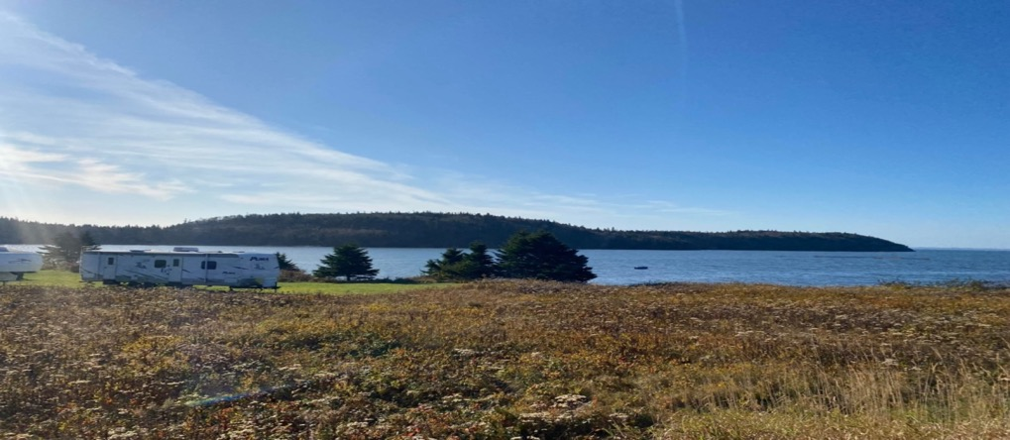

Slide 7
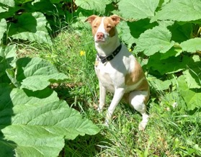
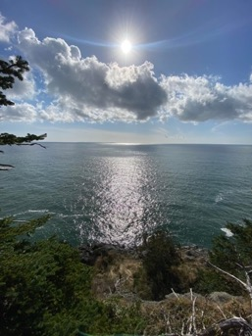
Background
The Landowners are Ernie & Judy Edwards.
They're originally from Massachusetts, USA and became landowners of Deadmans Head Forest two decades ago
Ernie & Judy engage with The Nature Trust of New Brunswick for effective and responsible stewardship for their land.
Interacting with the landowners, they were really interested to find out how their forests are reacting to climate change.
Our deliverable is to present a climate change management plan for the Deadmans Head Forest.

Slide 8
Recap
Establishing Baseline Data

Slide 10
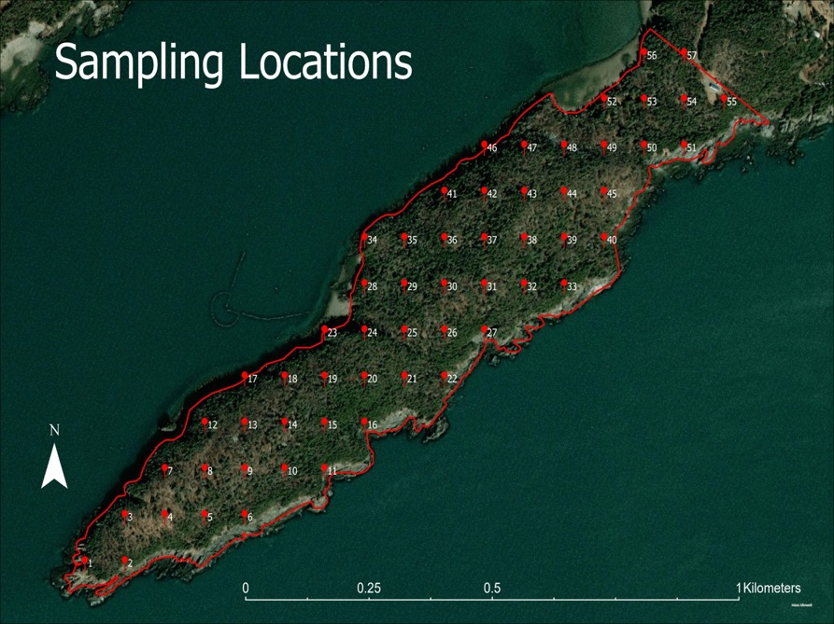
We used the Fishnet tool
on ArcGIS PRO to create a
systematic point sample
We then converted the point feature class to a GPX format
We uploaded the GPX file to Avenza Maps to help locate each point in the field.
Only 47 of 57 points were accessible in the field

Slide 11
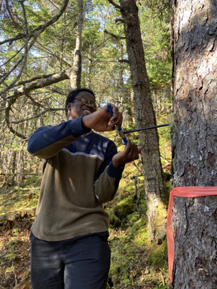
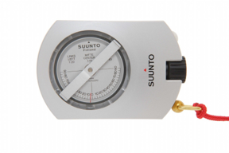
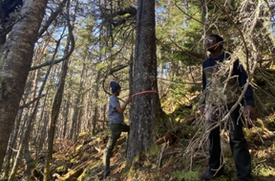
Recap: Field Methods
Area of 80 m ²
ID tree species
Circumference
Age
Height

Slide 12
Species Noted
Birds
Animals
(Other)
Understory
Bugs
Trees
8
6
13
13
7

Slide 13
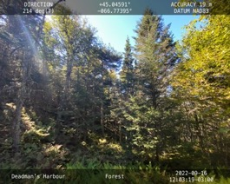
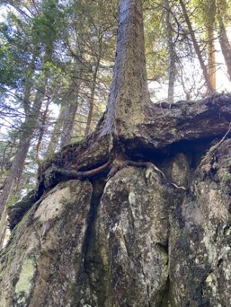
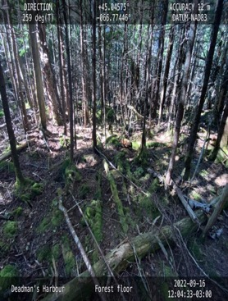
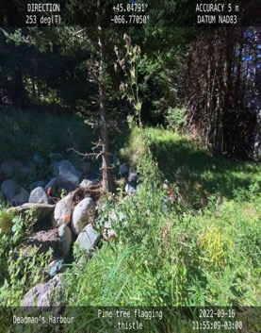
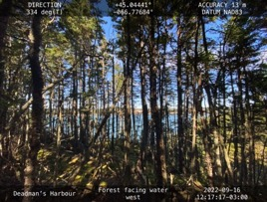
Recap through pictures

Slide 14
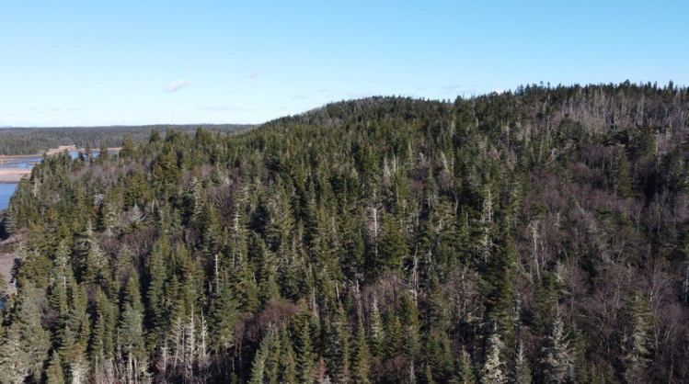
Drones

Slide 15
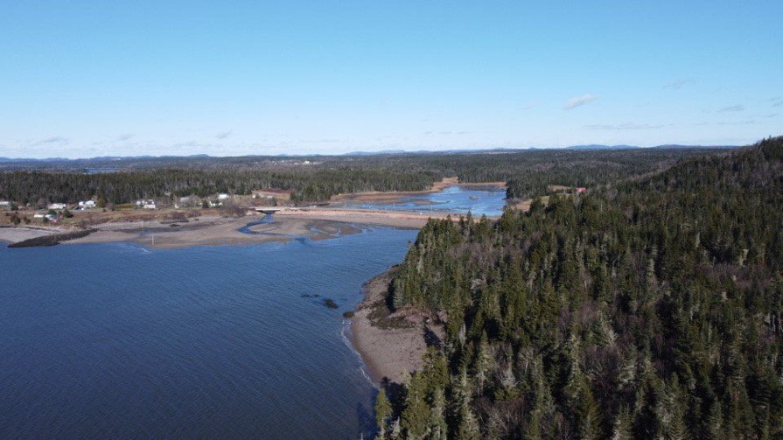
Drones

Slide 16
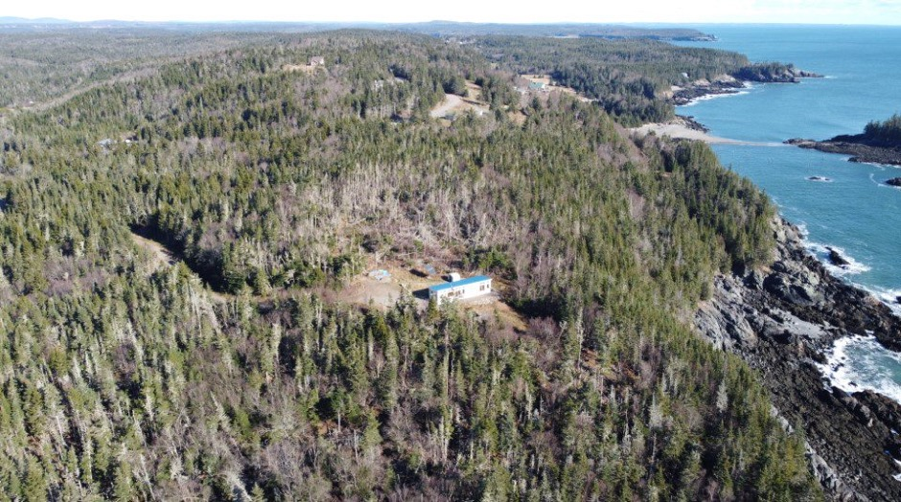
Drones

Slide 17
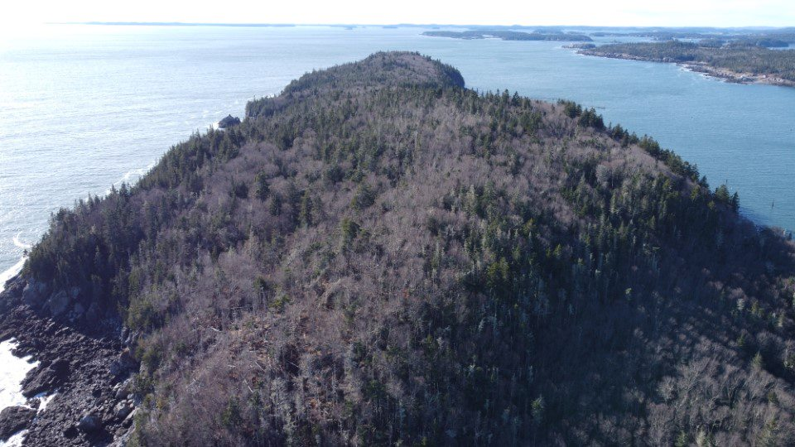
Drones

Slide 18
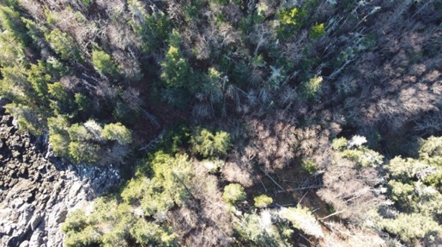
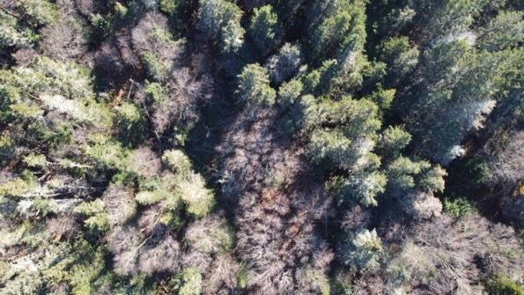
Drones

Slide 19
Tree data
Observations
Predictions for the future

Slide 20
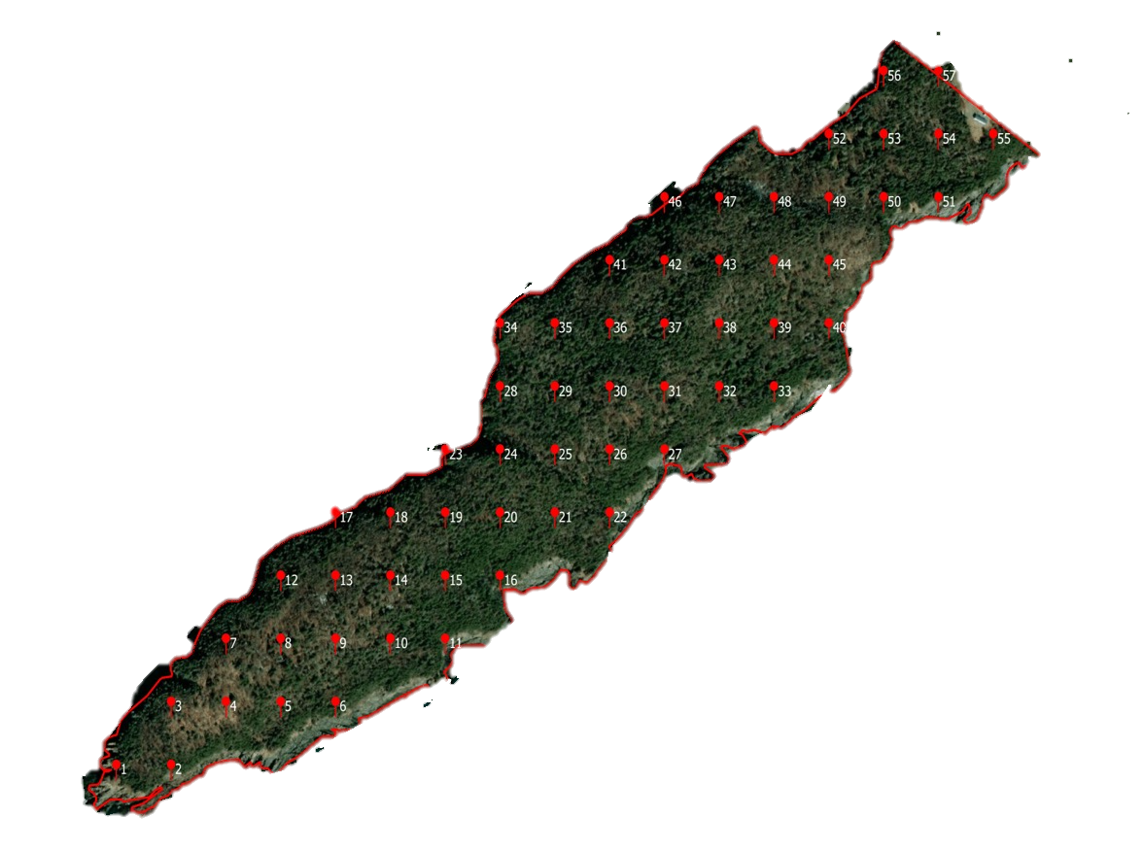
Species of Trees Found Throughout the Site
Fir
Ash
Birch
Pine
Spruce

Slide 21
Tree Species Sampled
55
41
Number of Trees
8
7
6
3
1

Slide 22
Average Old Growth Tree Age
103
Age (Years)
63
64
53
57
55
49
Notes:
154 – White Pine

Slide 23
Average Old Growth Tree Circumference
131
85
89
89
Circumference (cm)
70
66
67

Slide 24
Average Old Growth Tree Height
13.4
12
11.8
Height (m)
10.6
10.5
10.9
9.8

Slide 25
Climate Change Predictions

Slide 26
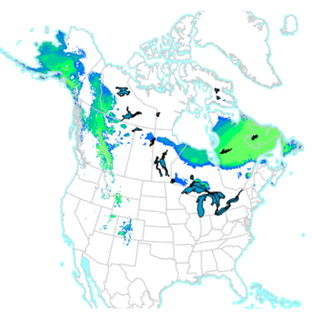
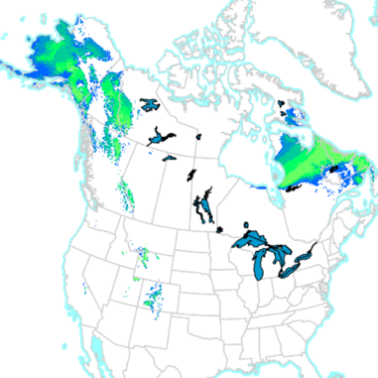
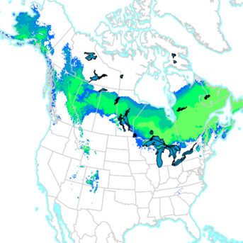
Balsam Fir
Balsam Fir is a medium-sized evergreen conifer with an average lifespan of 80 years.
Balsam Firs thrive in cooler climates and do not handle the heat well.
As a result, Balsam Firs are projected to decline in the province due to climate change.
2011-2040​
2041-2070​
2071-2100​

Slide 27
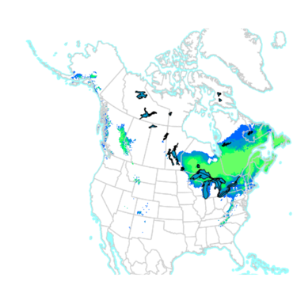
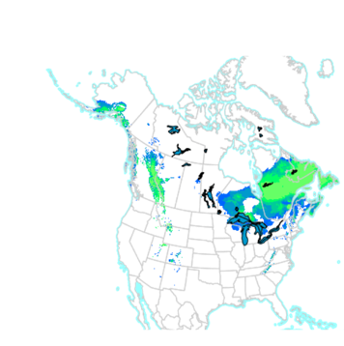
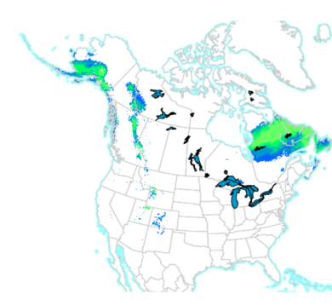
Yellow & Paper Birch
Yellow Birch is the longest living of the birch family with a lifespan of over 150 years
Birch thrives in a cool and humid environment
Birches are vulnerable to climate change as these trees are sensitive to increased temperatures and summer droughts
2011-2040
2041-2070
2071-2100

Slide 28
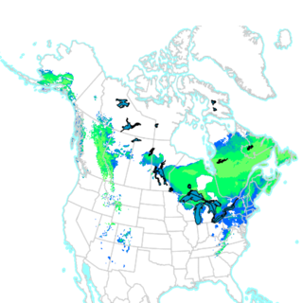
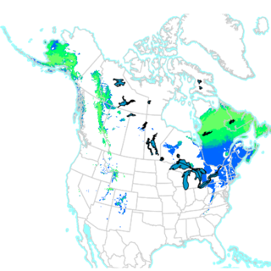
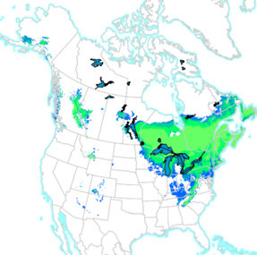
White Pine
White Pine is found in Elevated and sandy woodlands as well as in forested bogs.
White Pine has an average lifespan of 200 years with a maximum age of 450 years.
White Pine is expected to prosper and not be adversely affected by climate change in the Acadian region.
2011-2040
2041-2070
2071-2100

Slide 29
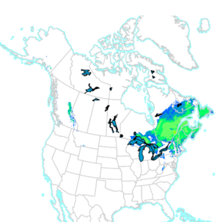
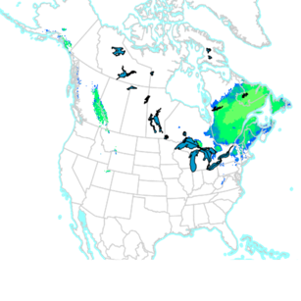
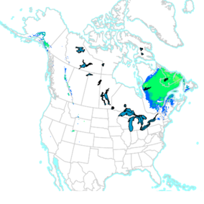
Red Spruce
Red Spruce has a lifespan of around 250-450 years
Requires cool moist summers and cold winters
Red Spruce is vulnerable to climate change as these trees are sensitive to increased temperatures.
2011-2040​
2041-2070​
2071-2100​

Slide 30
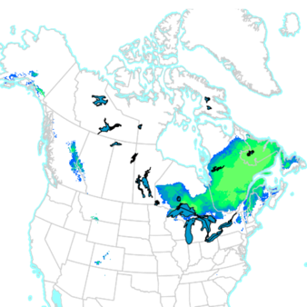
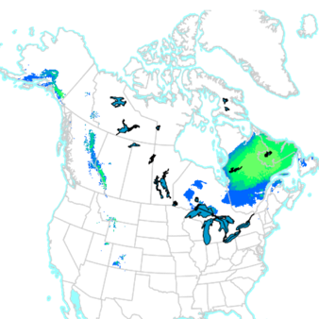
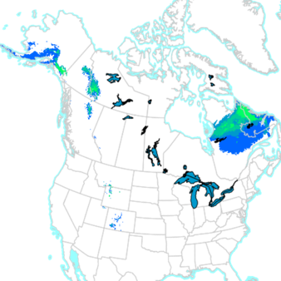
Mountain Ash
Mountain Ash has a height between 10-30ft
Mountain Ash has an average lifespan between 50-70 years
Mountain Ash would be affected by climate change.
2011-2040​​
2041-2070​​
2071-2100​​

Slide 31
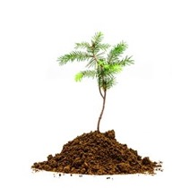
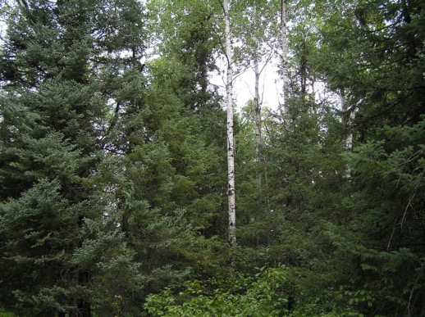
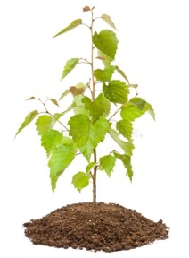
Special Note
Future Forest?
&

Slide 32
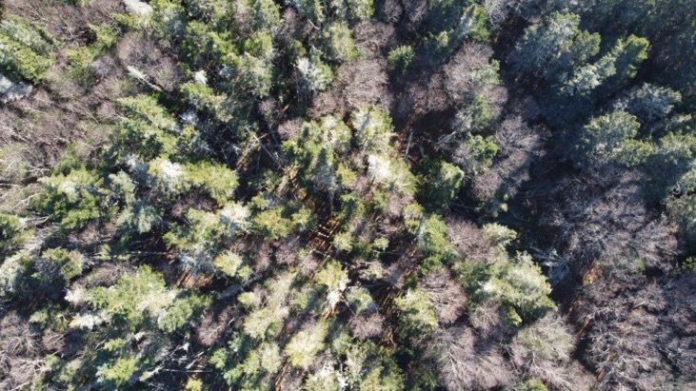
Future State of Forest
The forest is dominated by softwoods such as spruce, pine, and balsam fir which prefer cooler climates. As such they are projected to migrate northwards due to climate change.
The site in the future would be taken over by species that prefer a more temperate climate such as White Pine, Red Maple, American Beech, Red Oak, and Ironwood.

Slide 33
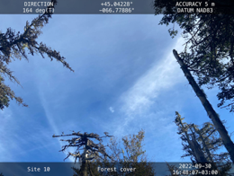
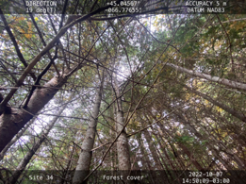
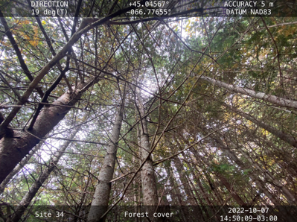
Canopy Coverage
Disease
Pests
Stress
Pollution Hazards
Good microclimate
Good nutrition
Healthy trees
Notes:
78% above 50% and 22% below 50%

Slide 34
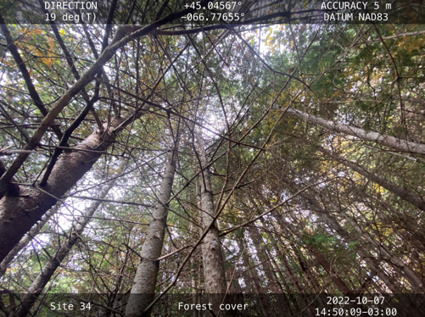
Canopy Coverage
Versus

Slide 35
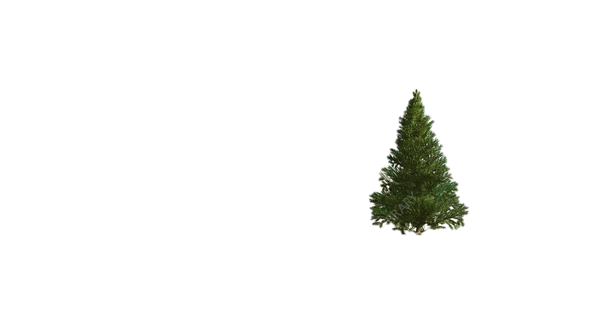
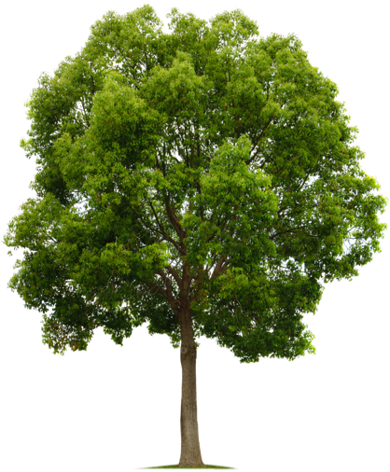
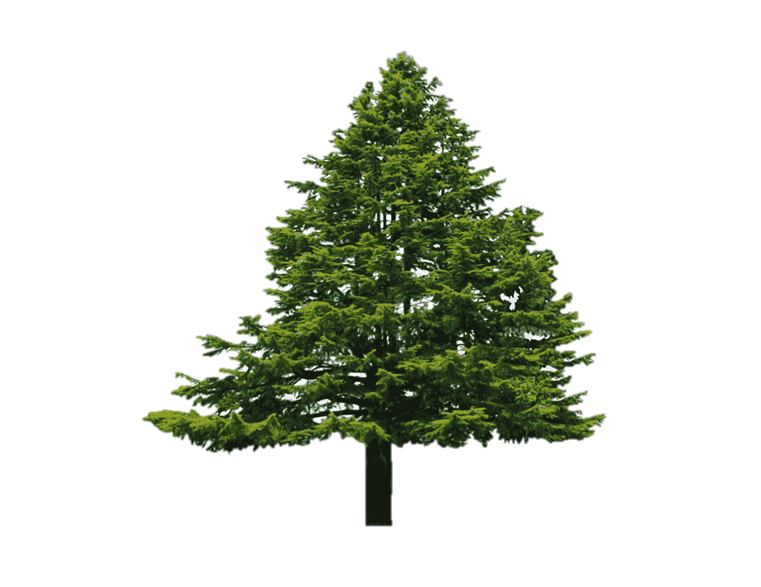
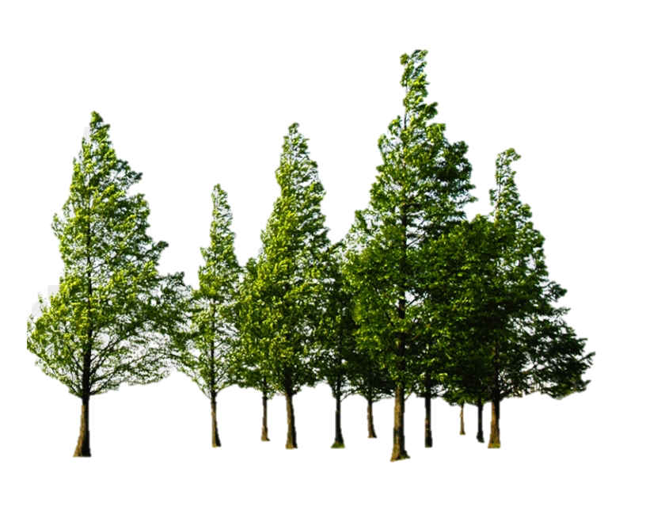
Soil Health
Multilayer Canopy Structure
↑ Soil Richness
↑ Infiltrability
↓ Erosion
↓ Soil︎ Loss
Notes:
Canopy Coverage Soil loss
Multilayer canopy structure, improves soil conditions and less erosion

Slide 36
Species
Impact on Species Observed
Future Species

Slide 37
Species Noted
Grey Squirrel
Black Bear
Frogs
Lichen
Norther Red Belt
Fern
Aster
Golden Rod
Strawberries
Wood Sorrel
Orange Jelly Spot
Wild Mint
Bald Eagle
Seagull
Partidge
Crow
Eastern Pheobe
Osprey
Heron
Woodpecker
Wood Louse
Bee
Moths
Woodchipper
Beetles
Monarch Butterflies
Common Fly
Mosquitos
Deerfly
Stink Bug
Horsefly
Hornet
Spiders
White Tail Deer
Red Squirrel
Porcupine
Notes:
Bear and Deer ,Status Secure Animals

Slide 38
Bald Eagle
Climate Change Facts
84% of their habitat lost by 2080
73% of their habitat recovered if they move north
Warm springs can put stress on the young
Forests fires are one their largest threats

Slide 39
Monarch Butterfly
Climate Change Facts
Sensitive to temperature changes
Milkweed are being affected as well – need to migrate North
Warm temperature affecting their migration
Less eggs laid due to rainfall
Extreme weather events South is declining the population
Forest degradation in the North is declining the population
11-57% Chance the Eastern population becomes extinct by 2036
Notes:
Mexico 2022– 80%
38% reduction in sites down South

Slide 40
Aster
Climate Change Facts
Species at risk
Prefer rich soils
Maine, Quebec, and New Brunswick
Important for Monarch Butterflies

Slide 41
Species Moving North
Invasive
2,000 species are moving away from the equator at an average rate of 5 meters per day
Stress on Habitats
Diseases
Notes:
Diseases caused by introduced fungi and insects, such as Dutch Elm Disease, Beech Bark Disease and Butternut Canker have changed the very composition of our forests.
Glossy Buckthorn, a European shrub, is aggressively spreading in many counties, crowding out native woodland and wetland plant communities.
Asian beetle Emerald Ash Borer, which will foreseeably spread to our province within a decade and by all indications may effectively eliminate all three of our native ash species.

Slide 42
NDVI
What is NDVI?
NDVI Map

Slide 43
What is NDVI Mapping
Red Light
Near-Infrared
Notes:
Healthy – Reflect More Infrared
Unhealthy – Absorb More Red Light

Slide 44
What is NDVI Mapping
$$NDVI= \frac{(NIR −RED)}{(NIR+RED)}$$
-1 to 0
0 to 0.33
0.33 to 0.66
0.66 to 1
Dead Plant
Unhealthy Plant
Moderately Healthy Plant
Healthy Plant

Slide 45
NDVI Map of Deadman’s Head
A
B

Slide 46
Results of NDVI Mapping
0.33 to 0.66
0.46
Moderately Healthy Plant

Slide 47
Climate Models
Climate predictions
LandSET Model
Wetlands
Future plans for the forest

Slide 48
Rising Temperatures
Climateatlas.ca (2022)
Notes:
Balsam fir and yellow birch to decline, white pine to preserve

Slide 49
Rising Temperatures
1980 | 2020 | 2080
5.9 °C
Climateatlas.ca (2022)
Notes:
Balsam fir and yellow birch to decline, white pine to preserve

Slide 50
Rising Temperatures
1980 | 2020 | 2080
5.9 °C | 7.1 °C
Climateatlas.ca (2022)
Notes:
Balsam fir and yellow birch to decline, white pine to preserve

Slide 51
Rising Temperatures
1980 | 2020 | 2080
5.9 °C | 7.1 °C | 11.0 °C
Climateatlas.ca (2022)
Notes:
Balsam fir and yellow birch to decline, white pine to preserve

Slide 52
Increased precipitation
Climateatlas.ca (2022)

Slide 53
Increased precipitation
1980 | 2020 | 2080
1215 mm
Climateatlas.ca (2022)

Slide 54
Increased precipitation
1980 | 2020 | 2080
1215 mm | 1279 mm
Climateatlas.ca (2022)

Slide 55
Increased precipitation
1980 | 2020 | 2080
1215 mm | 1279 mm | 1377 mm
Climateatlas.ca (2022)

Slide 56
LanDSET Model
Species specific environmental response: incident solar radiation, growing degree days, soil moisture (Bourque et al., 2000; Bourque and Hassan, 2008).
Landscape Distribution of Soil moisture, Energy, and Temperature
DEM
Slope
Soil moisture
Temperature/precipitation events
(Bourque and Hassan, 2008).
Notes:
is a process model that simulates land-surface energy transfer and hydrological processes in complex terrain, generating spatial calculations of incident solar radiation, evapotranspiration, and soil moisture, among other spatial variables. (Bourque and Hassan 2008).

Slide 57
LanDSET Model

Slide 58
LanDSET Model

Slide 59
October 2022

Slide 61
Future plans for the forest
Flooding
Erosion

Slide 62
Future plans for the forest
Monitoring after natural stresses like extreme climate or storms
Monitoring forest as climate changes overtime

Slide 63
Conclusions
Collected data
Species migrate North
Health of forest
Climate change impacts
Monitoring

Slide 64
References
Bourque, C. P.-A., Hassan, Q. K. (2008). Projected impacts of climate change on species distribution in the Acadian Forest region of eastern Nova Scotia. The Forestry Chronicle, 84 (4): 553-557.
Bourque, C.P.-A., F-R. Meng, J.J. Gullison and J. Bridgland. 2000. Biophysical and potential vegetation growth surfaces for a small watershed in northern Cape Breton Island, Nova Scotia, Canada. Can. J. For. Res. 30: 1179–1195.
Canada’s Plant Hardiness Site. (n.d.). http://planthardiness.gc.ca/index.pl?m=23
Climate Atlas (2022). Climate Altas of Canada. https://climateatlas.ca/map/canada/plus30_2030_85#
GISGeography (2022). What is NDVI (Normalized Difference Vegetation Index)? Accessed from: https://gisgeography.com/ndvi-normalized-difference-vegetation-index/
Rojo, J., Oteros, J., Picornell, A., Maya-Manzano, J. M., Damialis, A., Zink, K., Werchan, M., Werchan, B., Smith, M., Menzel, A., Timpf, S., Traidl-Hoffmann, C., Bergmann, K. C., Schmidt-Weber, C. B., & Buters, J. (2021). Effects of future climate change on birch abundance and their pollen load. Global change biology, 27(22), 5934–5949. https://doi.org/10.1111/gcb.15824
Trimble, S. (2021, September 20). Forest & Plant Canopy Analysis - Tools & Methods. CID Bio-Science. Retrieved November 30, 2022, from https://cid-inc.com/blog/forest-plant-canopy-analysis-tools-methods/
UN. (2020). Monarch Butterflies & Climate Change - Convention on the conservation ... Retrieved December 1, 2022, from https://www.cms.int/sites/default/files/publication/fact_sheet_monarch_butterfly_climate_change.pdf
GNB. (2022, March). Monarch, Danaus plexippus in New Brunswick: Status Report. Department of Natural Resources: Species at Risk Public Registry. Retrieved November 30, 2022, from https://www1.gnb.ca/0078/SpeciesAtRisk/search-e.asp
Audubon. (2014, September 16). Bald eagle. The Audubon Birds & Climate Change Report. Retrieved November 30, 2022, from https://climate2014.audubon.org/birds/baleag/bald-eagle
Mazerolle, D. (2019, November 22). Invasive species and climate change. Nature NB. Retrieved November 30, 2022, from https://www.naturenb.ca/2018/07/13/invasive-species-climate-change/
GNB. (n.d.). Forest Management Manual - gnb.ca. Government of New Brunswick. Retrieved December 1, 2022, from https://www2.gnb.ca/content/dam/gnb/Departments/nr-rn/pdf/en/Publications/ForestManagementManual.pdf

Slide 65
Questions?

