Slide 1
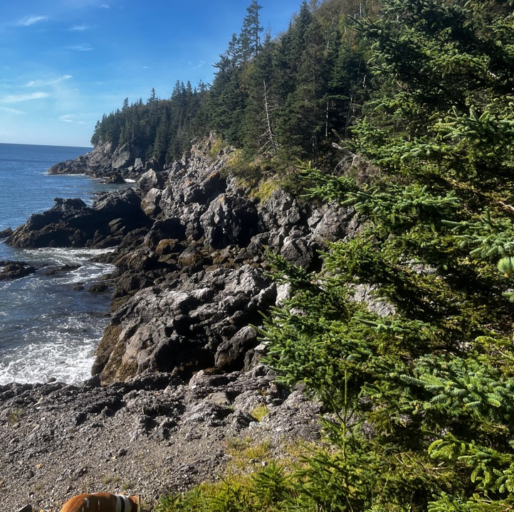
Deadmans Head Living Laboratory
ENVS6007: Practicum in Water, Wildlife, and Environmental Management
Allysia Murphy
Sarah Dooley
Allison Meister
Kianna Hughes Clarke
Dhiman Sen

Slide 2
Outline
Introduction
Methods
Species Data
Drone Data
Species Review
Discussion
Deadmans Head Living Laboratory

Slide 3
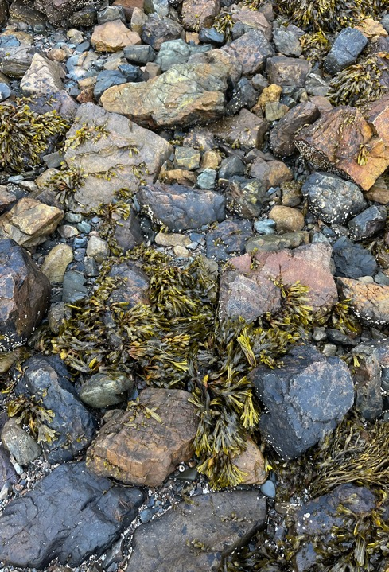
Introduction
Deadmans Head Peninsula
Living Laboratory
Phase one covered the forested peninsula
Project Scope

Slide 4
Introduction
The primary goals of the living lab
Identify and detail current species on and around the site using iNaturalist
Track over time how these species respond to climate change
Use remote tools to minimize human interaction with the site where possible
Share data
Preserve and protect their property

Slide 5
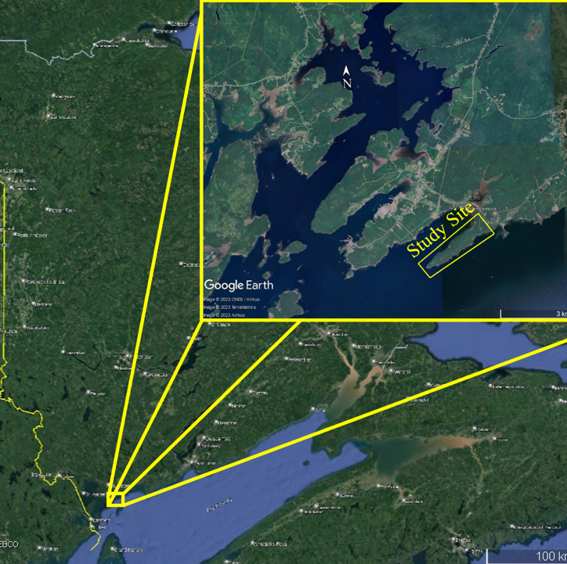
Site information
Located in the Village of Blacks Harbor
One side of the peninsula is the harbour, the cove side is on the Bay of Fundy
Beach site 1- Rocky beach with gravel and some larger rocky outcrops
Beach Site 2- Rocky beach with gravel and some larger rocky outcrops
Bay of Fundy Cove Site- Classic rocky shore with some steep cliff areas that face the Bay of Fundy
Deadmans Head Living Laboratory

Slide 6
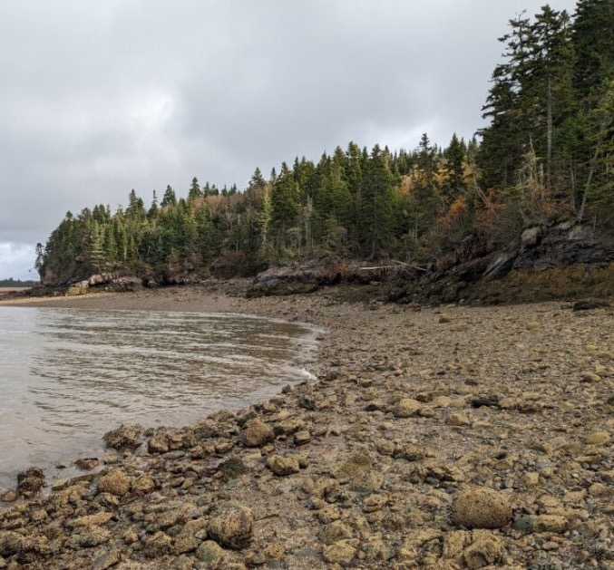
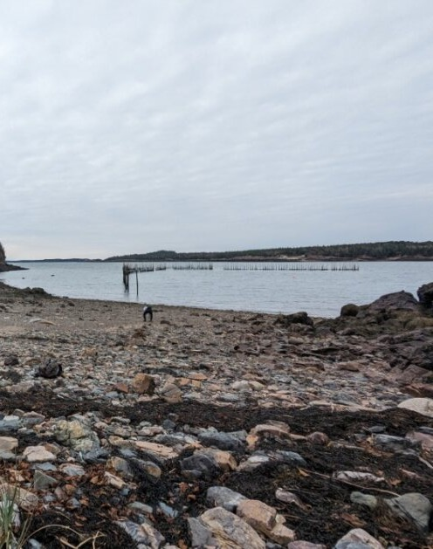
Deadmans Head Living Laboratory
6

Slide 7
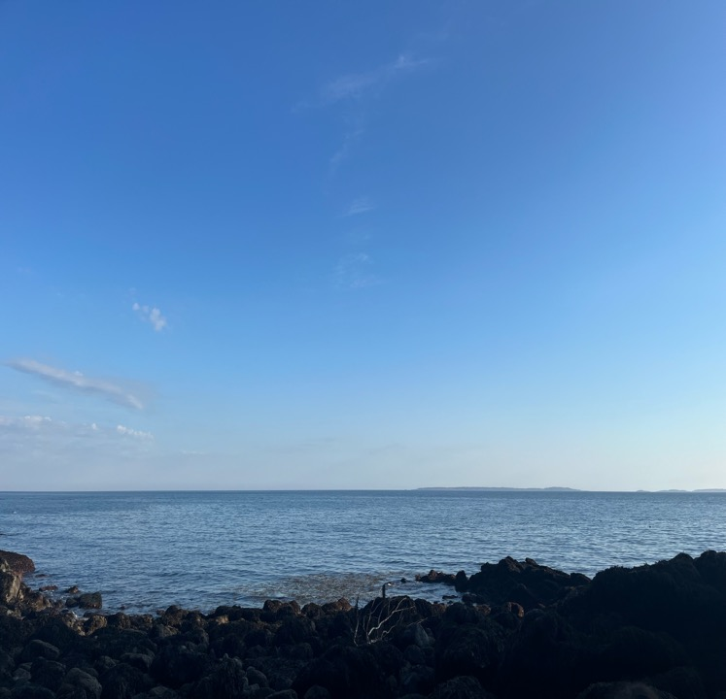
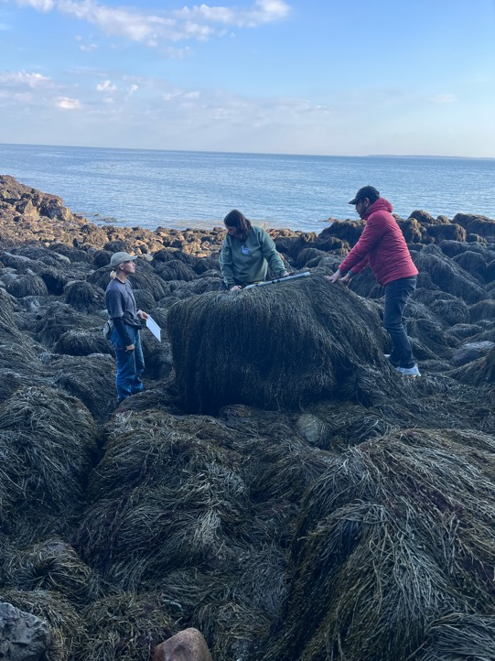

Slide 8
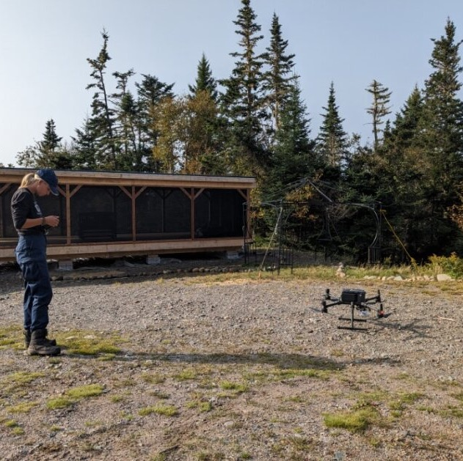
Methods
Literature Review
5 Site Visits
Species Identification
Transects & Quadrats
iNaturalist
Deadmans Head Living Laboratory
8
Notes:
Source for quadrats and species identification resources – Dr. Miriam Barbeau Coastal marine ecology class

Slide 9
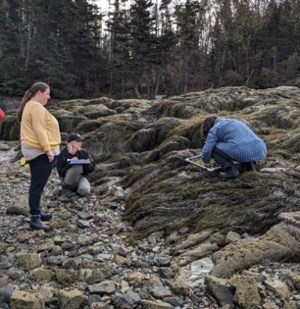
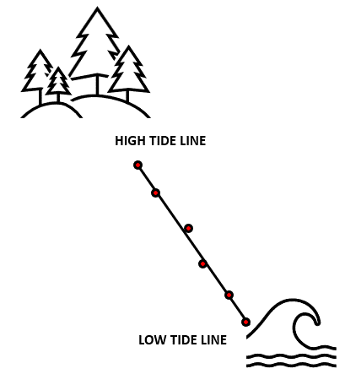
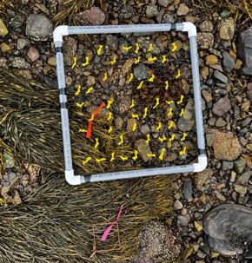
Transects & Quadrats
Beach One: 3 transects; 6 sampling points each
Beach Two: 2 transects; 6 sampling points each
Cove: 1 transect; 12 sampling points
Sampled algal and invertebrate species at each sampling point using quadrats

Slide 10
Field Research Dates
15 September
Initial site visit and property tour
1
27 September
Species identification practice @ Beach One and drone flying
2
20 October
Beach One data collection
3
27 October
Cove site data collection
4
3 November
Beach Two data collection
5
Notes:
Total group hours

Slide 11
Results – Time Spent
Notes:
Total group hours

Slide 12
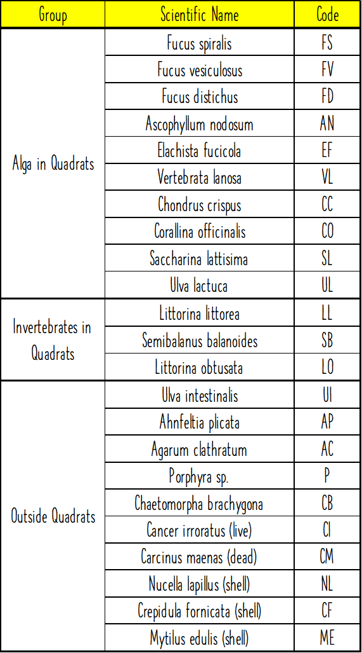
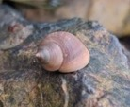
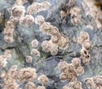
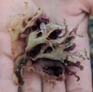
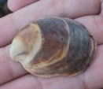
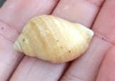
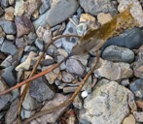
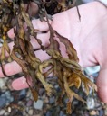
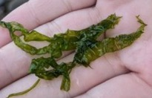
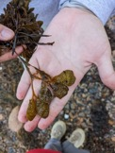
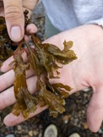
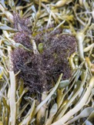
Results – Species Identified
In Quadrats:
Additional Species:

Slide 13
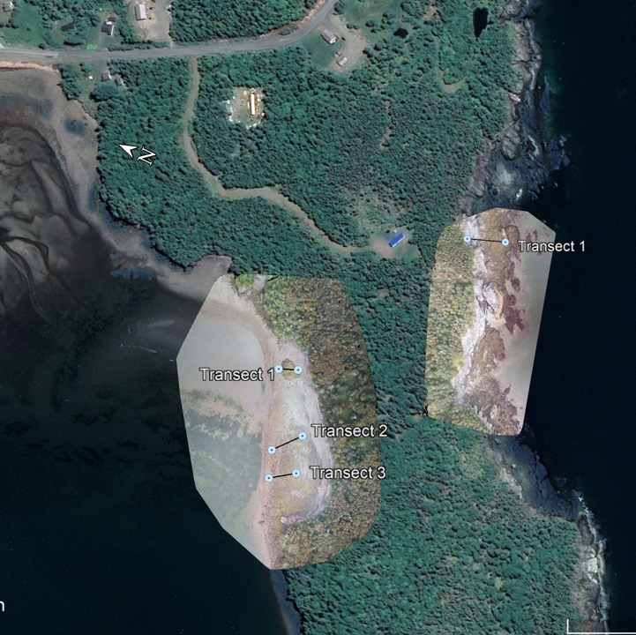
Drone Imagery
DJI Matrix 300 RTK
DJI Zenmuse XT2
4K visual camera
FLIR Tau 2 thermal sensor
Deadmans Head Living Laboratory
13

Slide 14
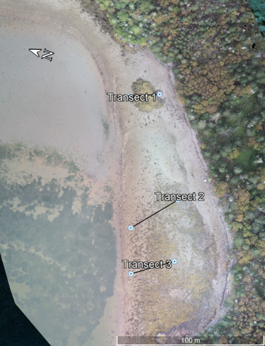
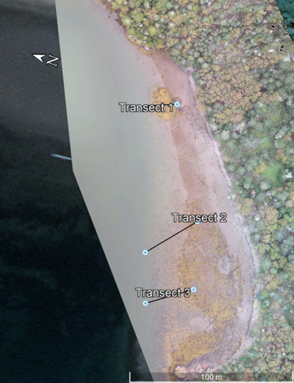
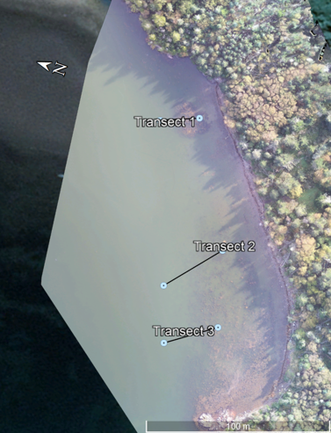
Beach 1
Low Tide
Mid Tide
High Tide
14

Slide 15
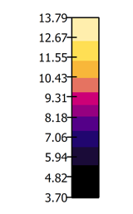
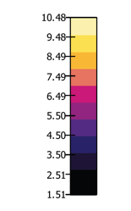
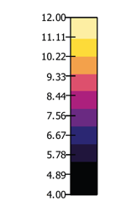
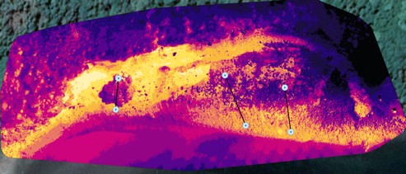
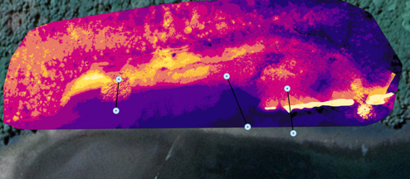
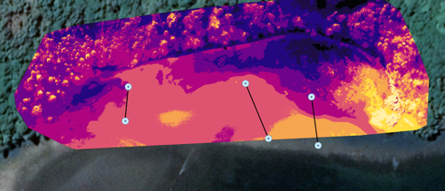
Beach 1 (TIR)
Low Tide
Mid Tide
High Tide
15

Slide 16
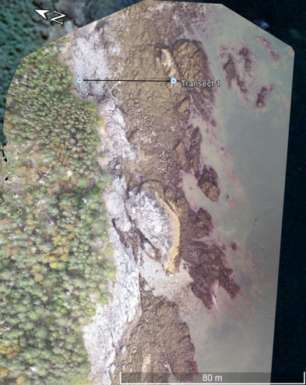
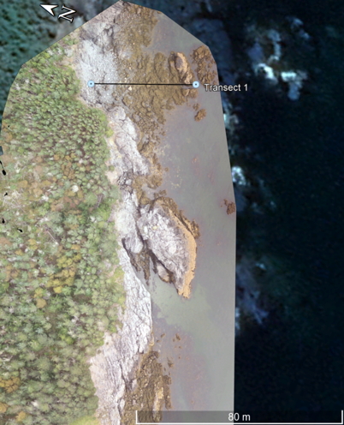
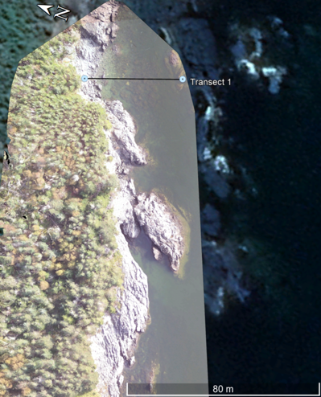
Cove
Low Tide
Mid Tide
High Tide
16

Slide 17
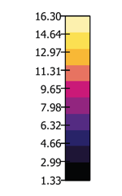
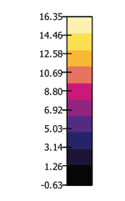
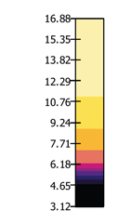
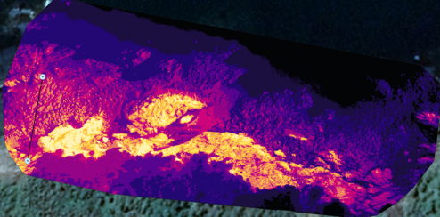
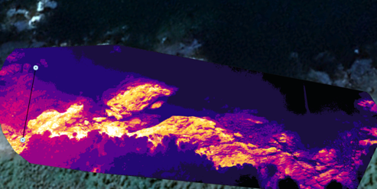
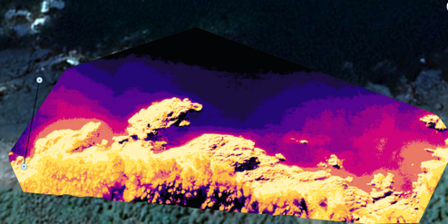
Cove (TIR)
Low Tide
Mid Tide
High Tide
17

Slide 18
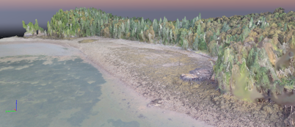
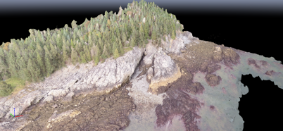
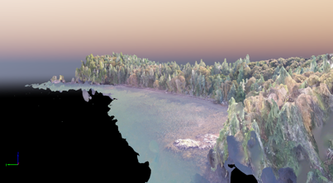
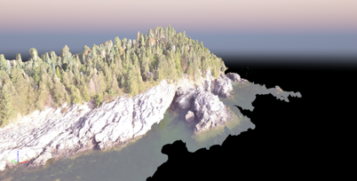
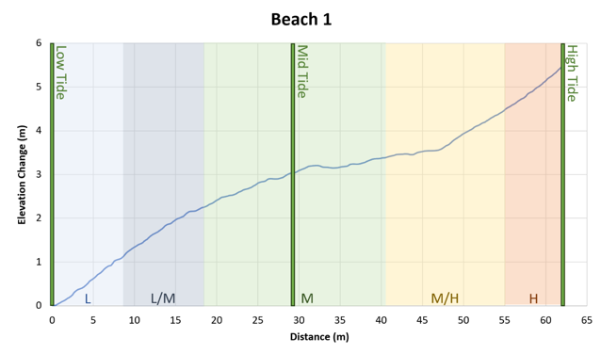
Elevation Data
Beach 1
Cove
18

Slide 19
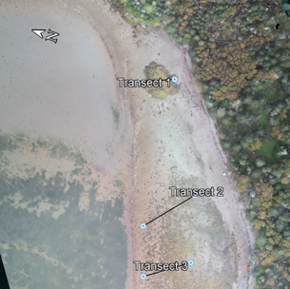
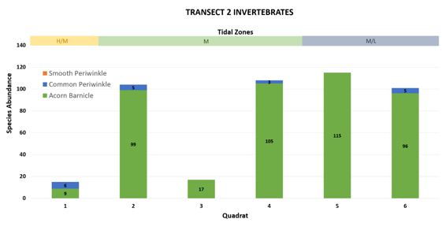
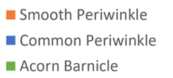
Beach One Invertebrate
19

Slide 20
Beach One Seaweed
20

Slide 21
Beach One Summary
21

Slide 22
Beach Two Invertebrate
22

Slide 23
Beach Two Seaweed
23

Slide 24
Beach TWO Summary
24

Slide 25
Summary of Both beaches
25

Slide 26
Cove Invertebrate
26

Slide 27
Cove Seaweed
27

Slide 28
Cove Summary
28
Notes:
Elevation profile could explain less visible trend; and true low tide zone

Slide 29
INaturalist
added 41 observations and 34 species
29

Slide 30
Species Review
Seaweed and Invertebrates
Marine Mammals and Fishes
Birds
20 Seaweed Species
15 Invertebrate Species
Susceptibility to 4 different environmental parameters
16 Species of Marine Mammals and Fishes
COSEWIC Report Assessments
Possible Impact from Climate Change
3 Bird Species
COSEWIC Report Assessments
Possible Impact from Climate Change
30

Slide 31
Climate Change Species Review
Seaweed
Invertebrate
Alaria esculenta
Ascophyllum nodosum
Fucus distichus
Fucus spiralis
Saccharina latissima
Modiolus modiolus
Asterias rubens
Littorina saxatillis
Littorina littorea
Littorina obtusata
Mytilis edulis
Cancer irroratus
Carcinus maenas
31

Slide 32
Climate Change Species Review
Marine Mammals and Fishes
Migratory Birds
Acadian Redfish
American Eel
American Plaice
Atlantic Salmon
Atlantic Cod
Harbour Porpoise
North Atlantic Right Whale
Leach’s Storm Petrel
Piping Plover
Red-Necked Phalarope
32

Slide 33
Future Impacts
Erosion
Climate Change Effects:
Sea level rise affecting erosion
More frequent/severe storms due to climate change
Resulting Impacts:
Intensified wave action and erosion
Cliff stability affected by freeze-thaw cycles
Loss of coastal vegetation weakens erosion defenses
Deadmans Head​ Living Laboratory​
33

Slide 34
Future Impacts
Coastal Flooding Risks at Deadmans Head Peninsula
Location Vulnerability: Low-lying areas (beach-1 & 2)
Factors Contributing to Flooding:
Rising sea levels due to global temperature increase
Climate change intensifies extreme weather events
Potential Impacts:
Increased frequency/severity of flooding
Higher storm surges during extreme events
34

Slide 35
Future Plans & Considerations
Study Focus and Limitation:
Single-season study at Deadmans Harbour
Importance of Long-Term Study:
Comprehensive understanding of climate impact
Examination of species abundance trends over decades
Potential Benefits:
Precision in trend identification
Creation of predictive models based on multi-year data
35

Slide 36
Future Plans & Considerations
Insights from Long-Term Study:
Informed strategies for ecosystem management
Changing species abundance
Considerations:
Adaptive management methodologies, Habitat restoration initiatives and Conservation measures
Deadmans Head Living Laboratory
36

Slide 37
Future Plans & Considerations
Future Study Plan:
Similar methodologies may be followed
Collaboration with local groups, NGOs, scientific organizations
Objective:
Enhanced data collection and sharing
Comprehensive understanding of coastal ecosystem impacts
Benefits:
Fostered collaboration for a deeper understanding of climate change
Deadmans Head​​ Living Laboratory​​
37

Slide 38
Limitations
Steep cliffs resistant to high tides
Sampling difficulty due to feasibility concerns
Limited suitable rocky shore locations
Study focused on one site in a particular season
Recommendations for Improved Precision:
Repetition across seasons or nearby coastal areas
Deadmans Head​​ Living Laboratory​​
38

Slide 39
Conclusion
Deadmans Head Living Laboratory
Various species will be impacted by climate change within this region
Protecting and continuing to research the sites analyzed is important to the sustainability of this area for future generations
39

Slide 40
Acknowledgements
Deadmans Head Living Laboratory
We would like to thank:
Ernie and Judy Edwards for their hospitality, support, and encouragement
Abby Evans and Briana Cowie for meetings and giving us valuable information
Fan-Rui and Kim for allowing us to participate in this project
40

Slide 41
Acknowledgements
We would also like to thank Seeley for making sure we did not get lost on the trails and for being the best help dog!
Deadmans Head Living Laboratory
41
Notes:
Source for quadrats and species identification resources – Dr. Miriam Barbeau Coastal marine ecology class

Slide 42
Thank you! Any Questions?
Allysia Murphy
Sarah Dooley
Allison Meister
Kianna Hughes Clarke
Dhiman Sen
Project Manager
Report Editor
Data Lead
Drone Analyst
Survey Assistant
42

